Slide 1
iDump Waste Classification System
ENVIRONMENTAL WASTE MANAGEMENT
Presented by: Harris Lukundi Annbellah Nduta Brian Muthama

Slide 2
Overview
Konza City Technopolis is a rapidly growing smart city in Kenya, aiming to be a hub of technology and innovation.
Environmental sustainability is a core focus for the city.
iDump has been contracted to develop an advanced waste segregation system to support the city's sustainability goals.
This system will help maintain cleanliness, reduce environmental impact, and promote recycling practices.

Slide 3
Problem Statement
Konza City faces significant challenges in managing the increasing volume of waste generated by its residents and businesses. Traditional waste management methods are inefficient and labor-intensive.
There is a pressing need for an accurate and efficient waste classification system.
Objective
Develop and deploy a robust image recognition system to enhance waste management efficiency in Konza City.

Slide 4
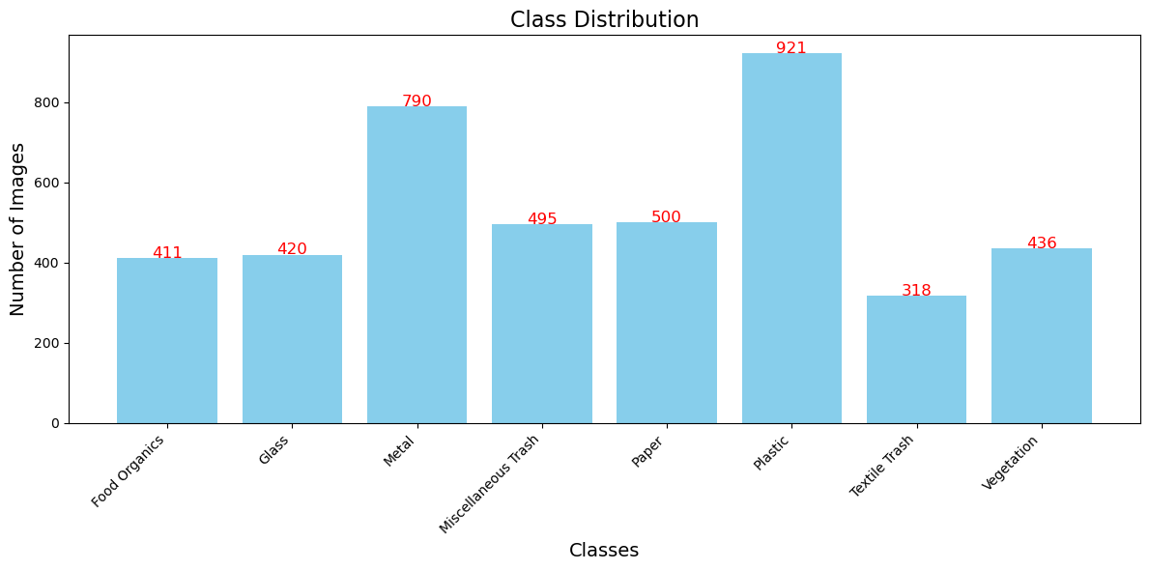
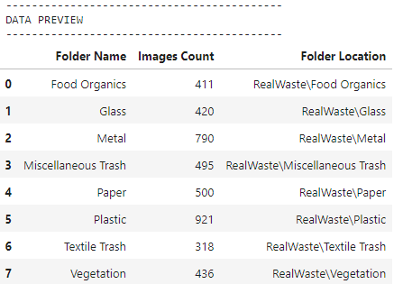
Data Understanding

Slide 5
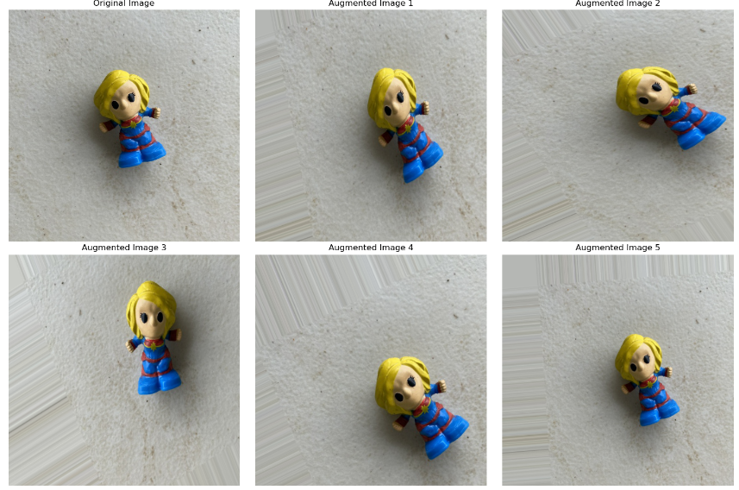
Data Preparation: Augmented Images

Slide 6
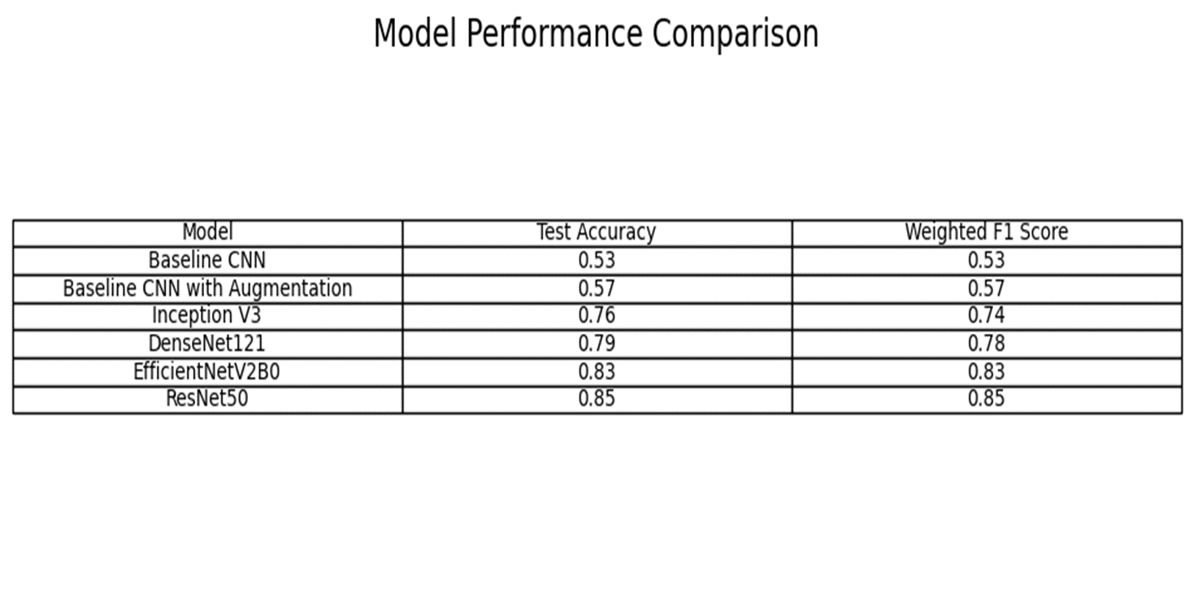
Modeling
Final Model: ResNet50 selected for deployment due to highest accuracy and F1 score

Slide 7
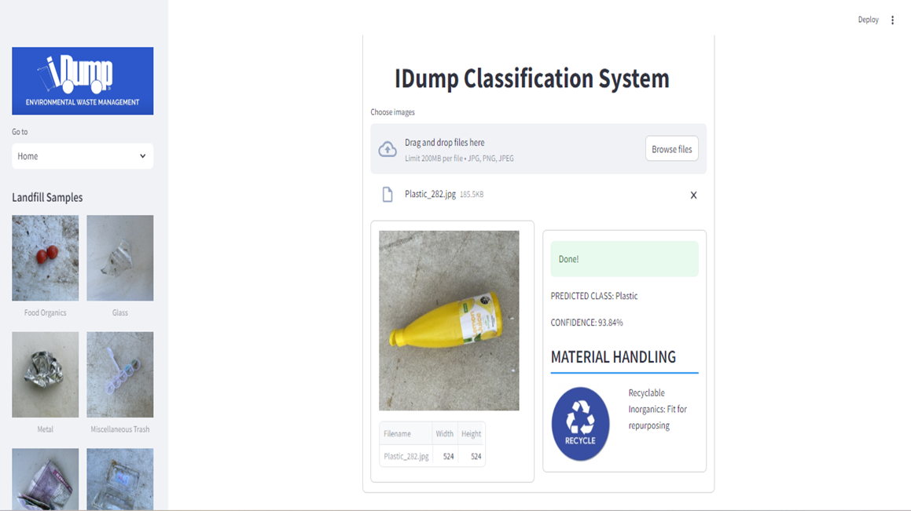
IDump Classififcation App

Slide 8
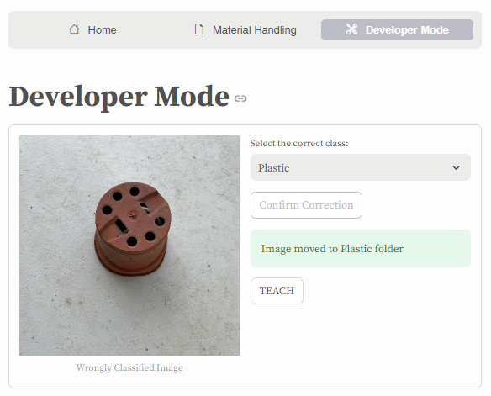
User Feedback
Classification Accuracy: Users can confirm if the classification was correct or incorrect.
Developer Mode: Misclassified images are moved to Developer Mode for further action, allowing continuous improvement of the model.

Slide 9
Conclusions & Recommendations
Conclusion:
Significant improvements in waste classification accuracy achieved.
The system effectively provides material handling guidelines based on classification results.
Recommendations:
Outsource compute to cloud servers with GPUs to enhance computational efficiency.
More data images is needed to train the models .
Expanding data image Diversity

Slide 10
Future Works
Short Term Goals
Long Term Goals
Expand dataset diversity to include more representative samples.
Optimize model architecture for deployment on edge devices.
Integrate with city-wide waste management systems for real-time tracking and reporting.
Collaborate with other smart cities for data sharing and model enhancement.
Develop real-time waste tracking and reporting systems.

Slide 11
Thanks!
Do you have any questions?

